Slide 1

Assessment of trustworthiness of online audited reflexivity
Frank LaBanca, EdD
Director

Slide 2
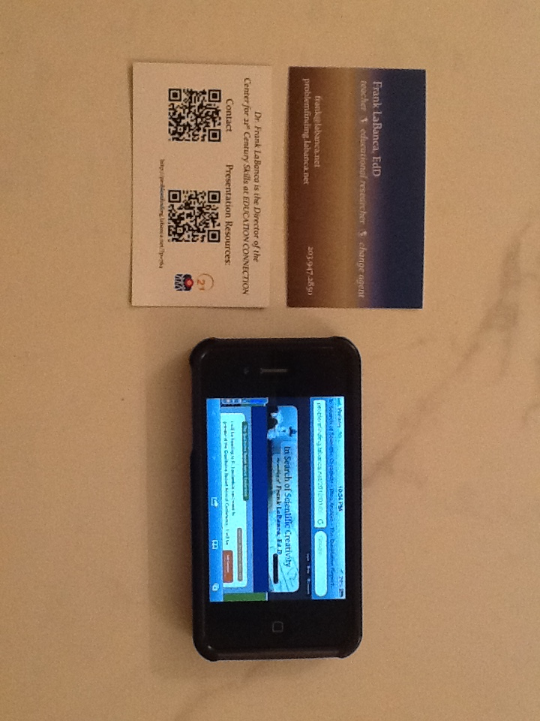
21st-century Approach to Presentation
Resources

Slide 3


Evolution of this research
What I’m not focusing on . . .
Multicase study of the impact of problem finding on the quality of authentic open inquiry science research projects.

Slide 4


Evolution of this research
What I am focusing on . . .
The impact of a novel reflexivity technique (reflective writing) on the emergent outcomes of the problem finding study.

Slide 5
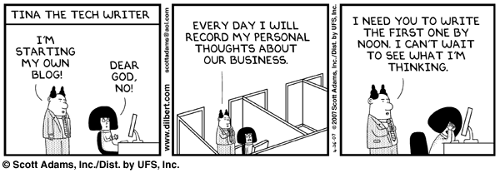
“Metareflexivity”
My role
My auditor’s role
Methods development

Slide 6
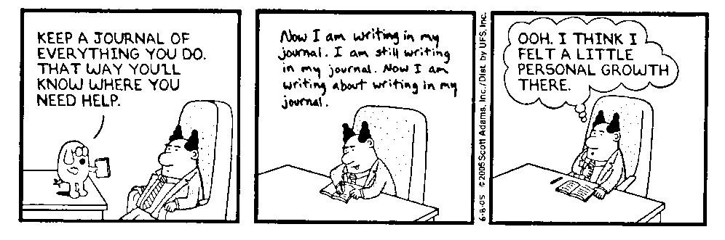
Characteristics of high quality reflexivity
Critical self reflection
Ongoing record of experiences, reactions, and emerging awareness of assumptions, biases, or positionality
Identifying, accepting, verifying, and/or unlearning of preconceived personal and theoretical commitments
Emerging awareness of ideas
Build trustworthiness

Slide 7
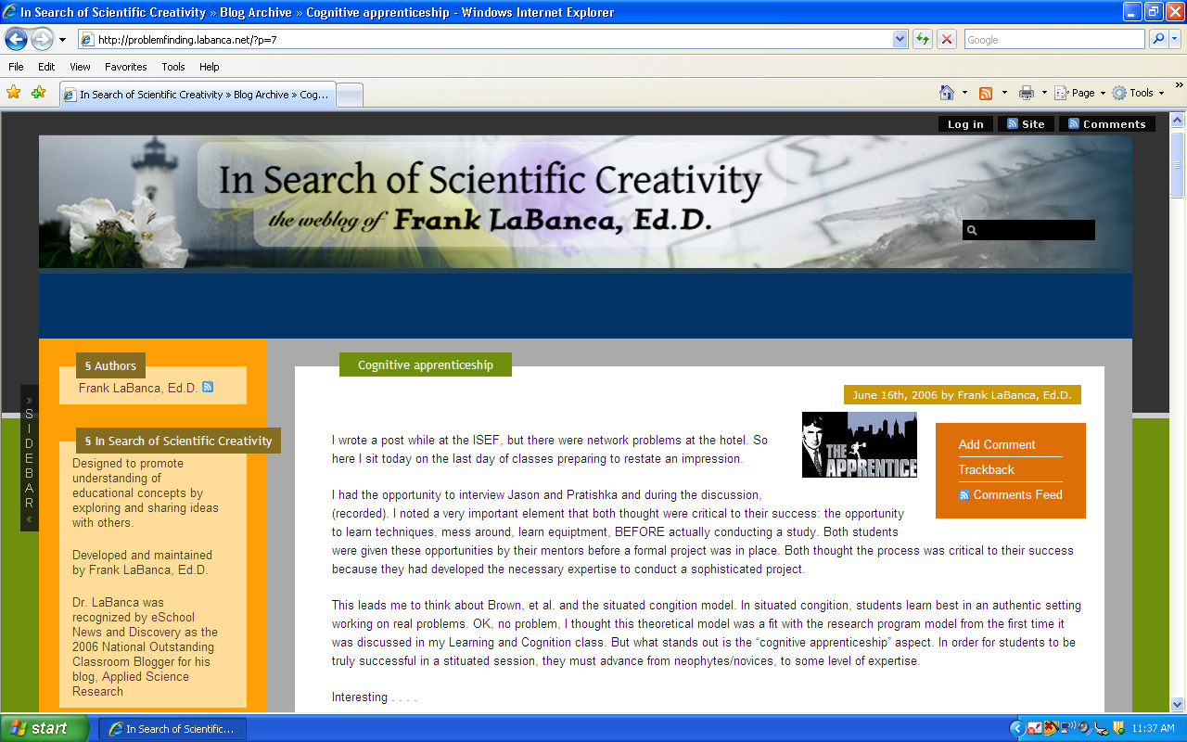

Slide 8
Data sample
Unit of study: “Post” – (my writing) 37 units
“Response” – (audits) 26 units
Lines of text: 2625
Pilot study
Study design
Data collection
Data analysis
Writing/Revising

Slide 9
Emergent Themes
Theme | Sample Code | Code definition
Describing Tasks | Define | Defining something
 | Elaborate | Providing context, elaboration of a statement, or an explanation
 | Task | Explaining what I'm doing
Concept building | Community | Workings of the science research community of practice
 | Role | Role of teachers, professionals, adults
 | Studbehav | Student behaviors
 | Theory | Linking behaviors to theory
Decision Points and Interaction | Consider | Considering alternatives
 | Emerge | What emerges from the data?
 | Solution | A possible solution to a problem
 | Advice | Taking advice from someone
 | Disagree | Disagreeing with a colleague
 | Opinion | Opinions of others that influence my thought
Metacognitive actions | Benefits | The benefits to a decision
 | Influence | How I am being influenced by my daily activities
 | Motivation | What motivates me (or someone else)

Slide 10
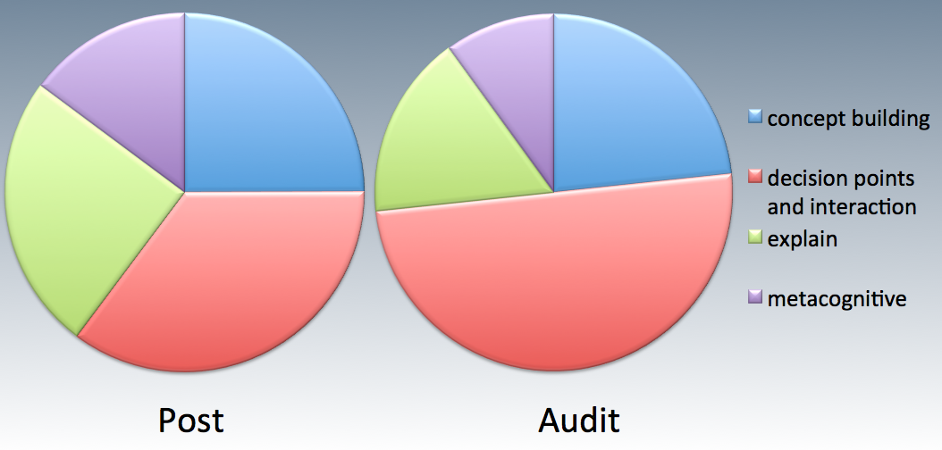
Distribution of Themes

Slide 11
Findings
Describing Tasks
  Explanations, often elaborated
  Audit trail for dependability
Concept Building
  Subject behaviors to theory
  Nature of socially constructing situated knowledge
  Auditors: Learning theory and alternate learning theory

Slide 12
Findings
Decision Points and Interaction
  Considering alternatives
  Evolution of ideas
  Auditors: Agree and consider
  Auditors: Influence on each other: elaboration
Metacognitive actions
  Influence of external factors: past, present, future
  Looking for clarification: process and change
  Auditors: Connecting with their own interests and passions.

Slide 13
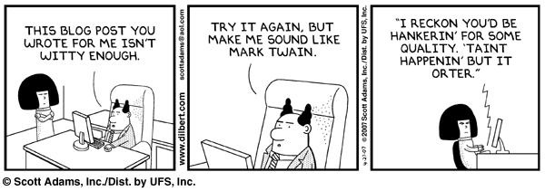
Benefits of a blog for reflexivity
Effective tool for qualitative research
Online, accessible, asynchronous
Ease of use
Convenience for auditors
Impact of auditors on each other for variety
Transparent

Slide 14
Limitations
Single case study
Bias towards technology
“Metareflexive”

Slide 15
Thank you
www.labanca.net
problemfinding.labanca.net

